Slide 1


REVIEW-1
ANIMAL
HEALTHCARE
Group No:309
Guided by : Dr. Saurabh Mishra

Slide 2
Submitted by
21BCG10127 - Devansh Biyani
21BCE10837 - Stiena Wilson Anthony
21BCE10457 - Vanessaa Syrish Daniel
21BCE11071 - Aryanshi Maheshwari
21BCE11558 - Harsh Kotiwale
21MIP10007 - Naman Mishra
21MIP10022 - Akshat Agrawal
21MIP10028 - Suman
Bhandari

Slide 3
Introduction Objective / Problem Literature Review Proposed work
INDEX
statement
Real time usage Hardware & software requirements
Overall system architecture diagram

Slide 4
INTRODUCTION
Our initiative focuses on creating a comprehensive solution for the well-being of animals, particularly street animals, and aims to bridge the gap between existing government policies and public awareness. By establishing animal care centers in various locations, we aim to provide accessible aid to animals in need. The goal is not only to promote and protect the animal world but also to create a clean and safe environment for both animals and humans. The initiative emphasizes community involvement and collaboration with government and organizations to ensure animals receive the necessary care, including shelter, food, and medical attention. Additionally, our website serves as an educational platform to raise awareness about animal care and maintenance, fostering a collective effort to improve the lives of animals and create a harmonious coexistence between humans and animals.

Slide 5
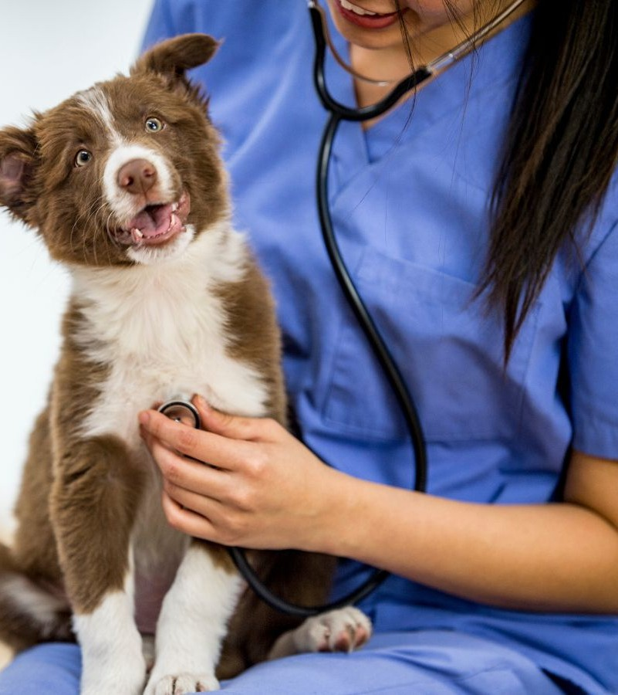
OBJECTIVE
To reach out all animals who need help
To provide better healthcare facilities to animal
To reduce a death ratio of street animals
To provide shelters to street animals
To provide dietitians,trainers,doctors to pet owners
To give information to NGO's about ownerless animals.
To help people who are making animal products by allowing them to sell the product to websites.
To set up healthcare centers at multiple locations
To arrange all facilities with government and public donation in favor of animals

Slide 6
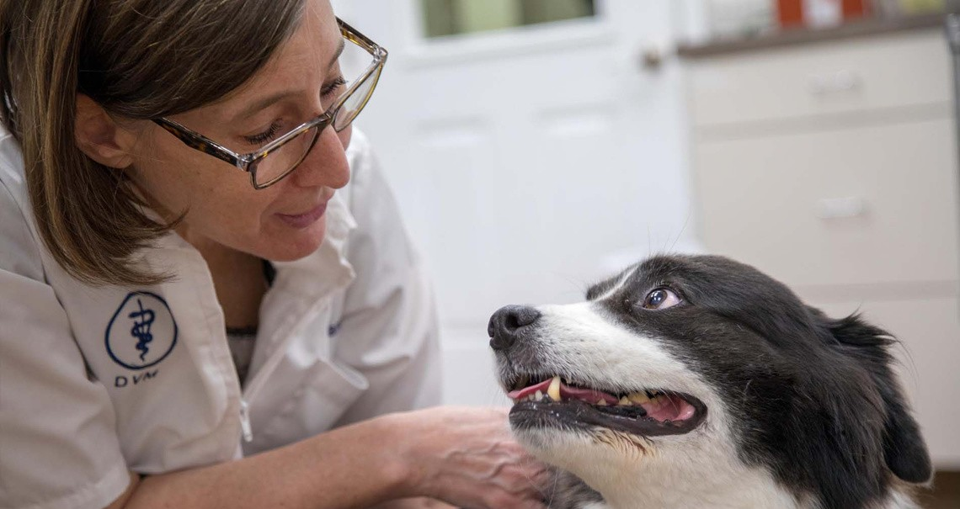
Literature Review
Many programmes in the field of animal healthcare are aimed at enhancing the welfare and health of domesticated animals, wild animals, and cattle. A survey of the literature on projects aimed at improving the health of animals finds a variety of methods, including vaccination campaigns, disease surveillance and control, veterinarian care and training, and public education and awareness campaigns.
one study, conducted by Dohoo et al. in 2017
Study by Bhanderi et al. (2015) looked at the influence of vaccination programmes
research conducted by Kumar et al. (2018) assessed the effectiveness of a veterinary outreach programme
4 Ramachandran et al. (2018) initiated awareness campaigns Overall, the literature review emphasizes the value of an integrated strategy for animal healthcare, with an emphasis on illness prevention, veterinarian treatment, and training, as well as public awareness and education campaigns.

Slide 7
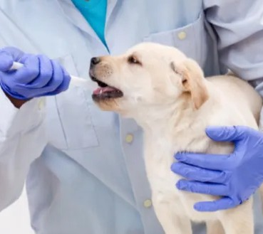
PROPOSED WORK
A website that offers food shelters and medical care is being developed to serve as a one-stop shop for animal welfare. The website offers details on medical professionals, non-governmental organizations, and animal welfare groups. The idea is to open healthcare facilities and offer financing and other forms of support in order to offer assistance more effectively.
The website offers a thorough directory of doctors and only requires one signup. Government funding will enable the project's expansion. In addition, street cameras will be installed to offer emergency assistance, and a sensor to identify animal injuries will be developed. Providing a one-stop shop for all animal needs is the aim.

Slide 8

REAL-TIME USAGE
animal healthcare involves practical applications and interventions that are implemented immediately to address the health and well-being of animals.
Emergency Medical Response Vaccination Drives
Disaster Relief
Mobile Veterinary Clinics Monitoring and Surveillance Livestock Health Management Public Awareness Campaigns Research and Development

Slide 9
Hardware & software requirements
FRONT-END BACKEND

Slide 10
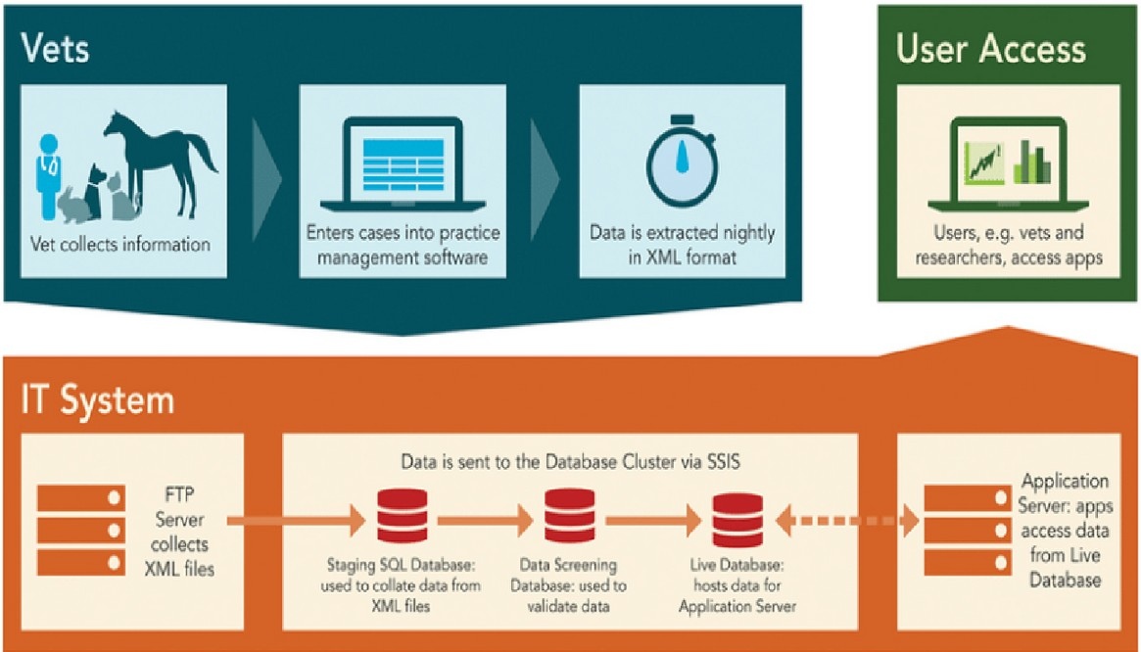
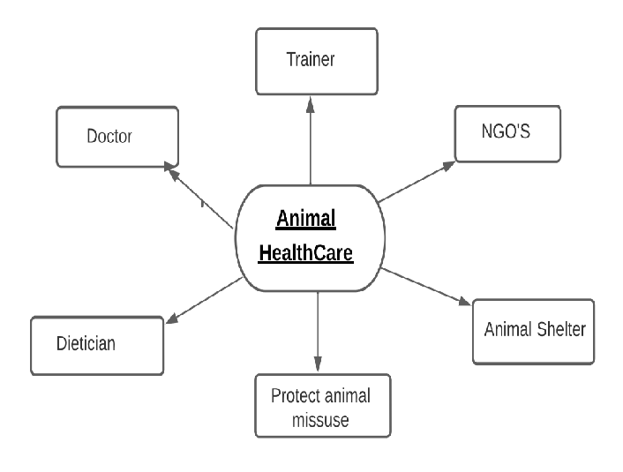
Overall system architecture
diagram

Slide 11
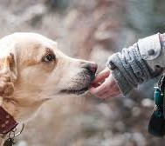
Conclusion
An ecosystem that can support every animal in a variety of ways in one place is needed by society. Through web development, we are trying to create this environment by giving users access to all services related to pets. Additionally, we are making every effort to address the problem of street animals. We are constructing a bridge to connect all of the missing animals with the numerous NGOs that are dedicated to the welfare
of animals in our society, despite the fact that many animals remain missing. Users can upload their products related to animals as well.
Consequently, every need can be met by the producer as well as the consumer.

Slide 12
http://animalhealthcare.com
Reference
https://sarvoham.org/downloads/Pet%20Diet%20Chart.pdf
https://petnutritionalliance.org/site/pnatool/creating-nutrition-plan/
https://en.wikipedia.org/wiki/Veterinarian
https://www.careers360.com/careers/animal-trainer
https://www.petaindia.com/? utm_source=PETA%20IN%3A%3AGoogle&utm_medium=Ad&utm_campaign=1 121%3A%3Agen%3A%3APETA%20IN%3A%3AGoogle%3A%3ADSA-
Grant%3A%3Aeg%3A%3Asearchad&gclid=CjwKCAiA76- dBhByEiwAA0_s9S1Mq_f4CQL-Qe6CqWVRYuOMP02FO- HuZKNDcUSZMHpdEQLkzTFYHRoCt7YQAvD_BwE

Slide 13
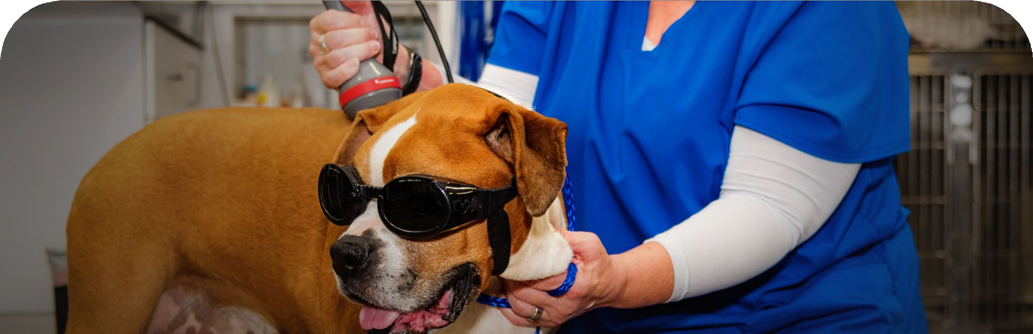
Thank you

